Slide 1
VoIP Tutorial
Brian Rosen
Distinguished Engineer
Neustar, Inc.

Slide 2
What Is Internet Protocol?
A way to send data on a high speed network
Data is broken up into packets, which are variable sized
A packet is a sequence of bytes, with a “header” and a “payload”
Data is typically sent serially, bit by bit, byte by byte
IP is a layered protocol

Slide 3
“Trace Route” - UPS version
Location Date Local Time Activity
Zelienople, PA, United States 05/27/2014 11:40 A.M. Delivered
05/27/2014 7:03 A.M. Destination Scan
05/27/2014 6:43 A.M. Arrival Scan
Pittsburgh, PA, United States 05/27/2014 6:15 A.M. Departure Scan
Pittsburgh, PA, United States 05/24/2014 6:00 A.M. Destination Scan
05/24/2014 5:54 A.M. Arrival Scan
Louisville, KY, United States 05/24/2014 4:47 A.M. Departure Scan
05/24/2014 12:28 A.M. Import Scan
Louisville, KY, United States 05/23/2014 2:37 P.M. Import Scan
05/23/2014 1:30 A.M. Arrival Scan
Anchorage, AK, United States 05/22/2014 3:37 P.M. Departure Scan
05/22/2014 1:51 P.M. Arrival Scan
Shanghai, China 05/22/2014 8:58 P.M. Departure Scan
Shanghai, China 05/21/2014 7:51 P.M. Export Scan
05/21/2014 4:25 P.M. Arrival Scan
05/21/2014 4:10 P.M. Departure Scan
05/21/2014 2:52 P.M. Origin Scan
China 05/21/2014 12:07 A.M. Order Processed

Slide 4
“traceroute” - IP network version
traceroute to pdx.edu (131.252.115.23), 64 hops max, 52 byte packets
1 10.33.192.2 (10.33.192.2) 20.692 ms 21.152 ms 20.891 ms
2 stco6509a-gi-3-2.va.neustar.com (10.33.0.6) 31.958 ms 21.069 ms 20.038 ms
4 stsc1285b-eth-s1s1p2.va.neustar.com (10.91.0.3) 22.745 ms 22.654 ms 27.122 ms
5 209.173.53.226 (209.173.53.226) 26.276 ms 24.248 ms 25.873 ms
6 dcx2-edge-02.inet.qwest.net (65.123.192.93) 32.139 ms 29.091 ms 22.520 ms
7 dcp-brdr-04.inet.qwest.net (67.14.28.34) 24.099 ms 52.813 ms 27.055 ms
8 te0-16-0-14.ccr41.iad02.atlas.cogentco.com (154.54.12.245) 23.296 ms 22.105 ms
be2176.ccr21.dca01.atlas.cogentco.com (154.54.41.54) 23.200 ms
be2154.ccr41.ord01.atlas.cogentco.com (154.54.30.198) 50.699 ms
be2159.mpd22.mci01.atlas.cogentco.com (154.54.24.81) 70.447 ms
be2131.ccr22.den01.atlas.cogentco.com (154.54.26.129) 73.082 ms 75.397 ms
13 be2127.ccr21.slc01.atlas.cogentco.com (154.54.25.70) 102.761 ms
te4-2.ccr01.boi01.atlas.cogentco.com (154.54.40.90) 96.096 ms
te0-0-0-2.rcr11.pdx02.atlas.cogentco.com (154.54.40.97) 97.065 ms
te2-7.ccr01.pdx01.atlas.cogentco.com (154.54.0.85) 95.403 ms
portlandstateuniversity.demarc.cogentco.com (38.99.222.130) 98.326 ms 98.469 ms 97.227 ms
131.252.5.220 (131.252.5.220) 94.479 ms 95.821 ms 93.371 ms
22 131.252.115.23 (131.252.115.4) 96.072 ms !H 98.743 ms !H

Slide 5
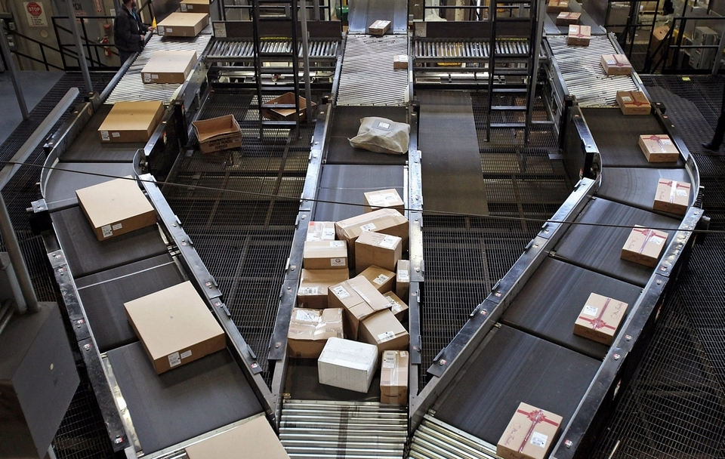
Package Switching Network

Slide 6
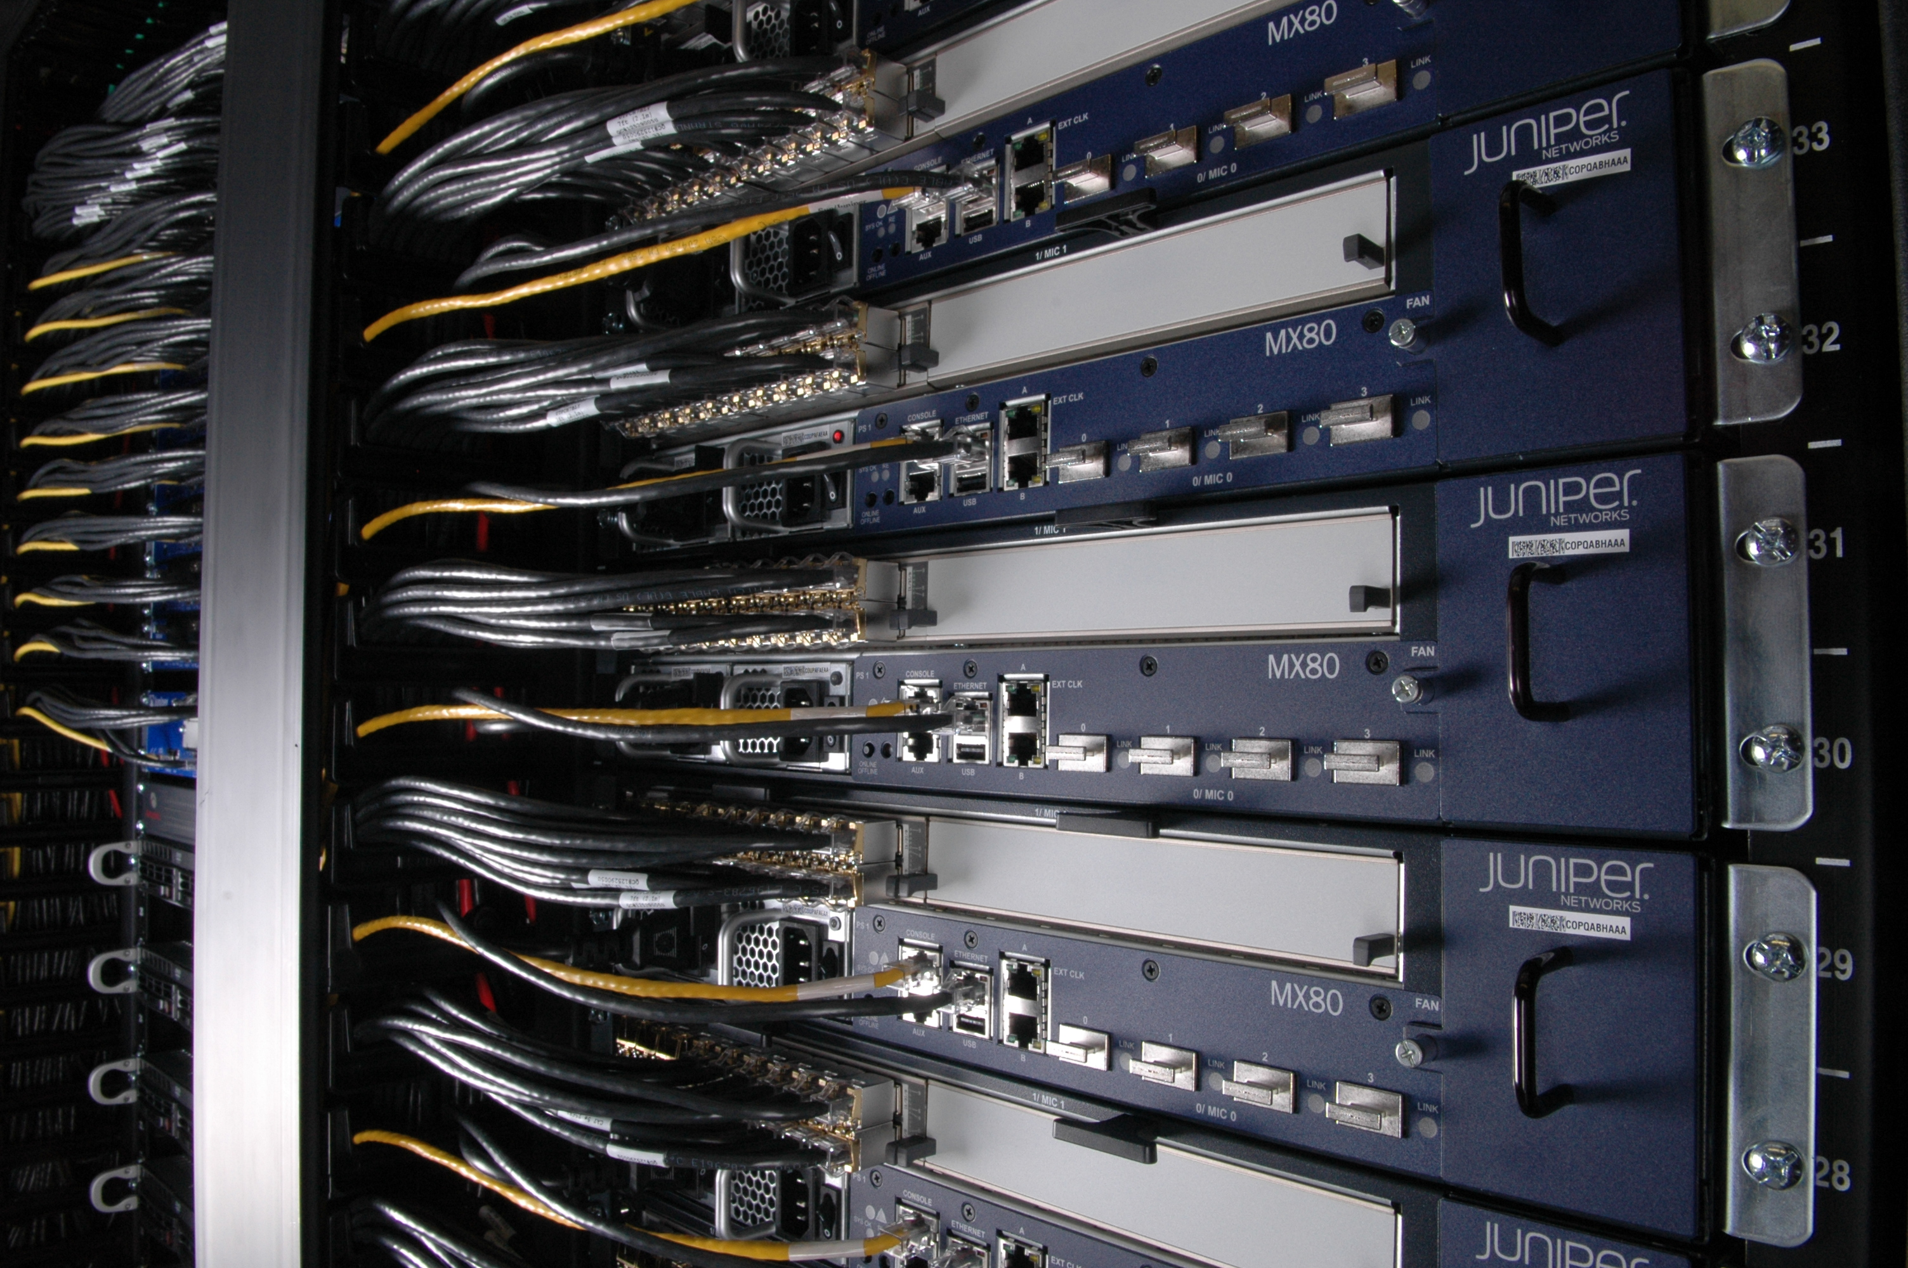
Packet Switching Network

Slide 7
TCP/IP architecture
 |  OSI- Model |  |  |  TCP/IP - Model
 7 | application |  |  | application
 6 | presentation
 5 | session
 4 | transport |  |  | transport
 3 | network |  |  | network
 2 | datalink |  |  | link
 1 | physical

Slide 8
Protocol Layering
User data
Application byte stream
TCP Header
TCP segment
IP
Header
IP datagram
Network
Header
Network-level packet

Slide 9
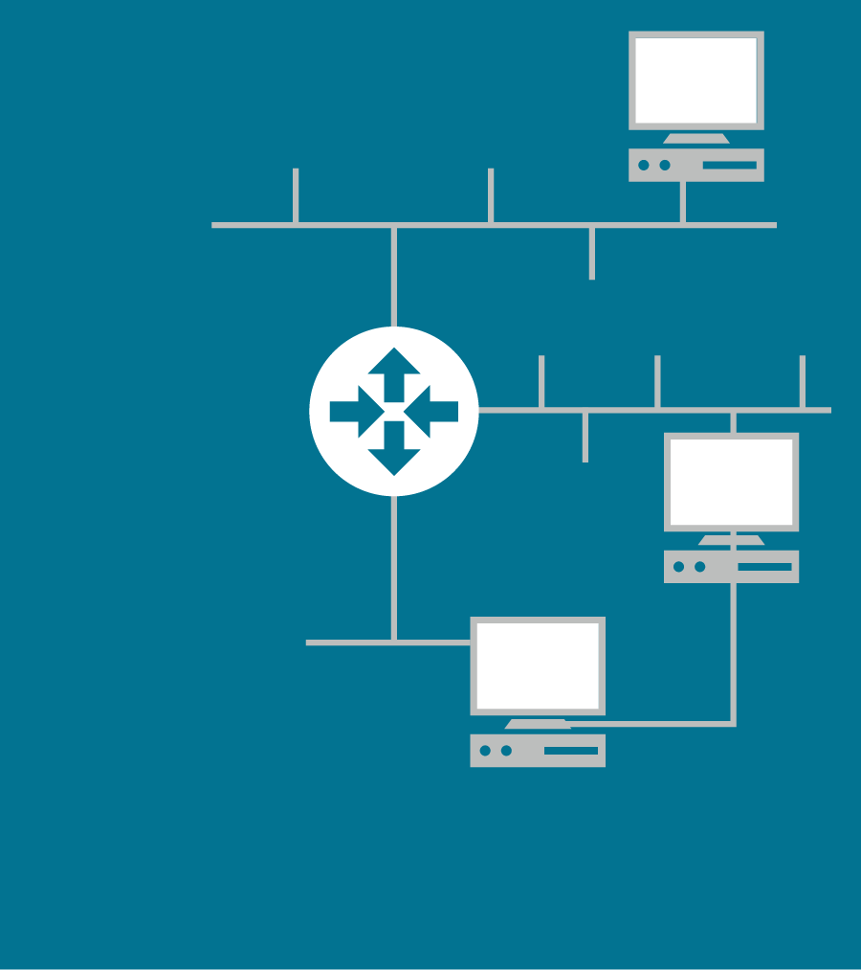
Routing Basics
LAN B
Q
Routers have multiple ports
Maintain a “Routing Table” mapping network IDs to ports
Copies packets from one port to another
Ports don’t have to be the same link type
Router X
2
3
LAN C
R
1
LAN A
Network | Port
P | 1
Q | 2
R | 3
P

Slide 10
Routing Basics
Typically, with a collection of routers, there is more than one way to get from A ➔ B
The job of the router is to recieve a packet on one of its ports and send it to the next hop router on another one of its ports based on the IP address of the destination
Routers choose the “best” next hop (port) that they know at the time
“Best” is in the eyes of the beholder
Can consider pipe size, delay, error rates, etc
Each route has a metric, routers chose routes based on the metric
“Routing Protocols” (e.g. RIP, IGMP, ISIS, BGP) distribute routes and routing metrics among routers
These protocols run between routers and are not visible to users

Slide 11
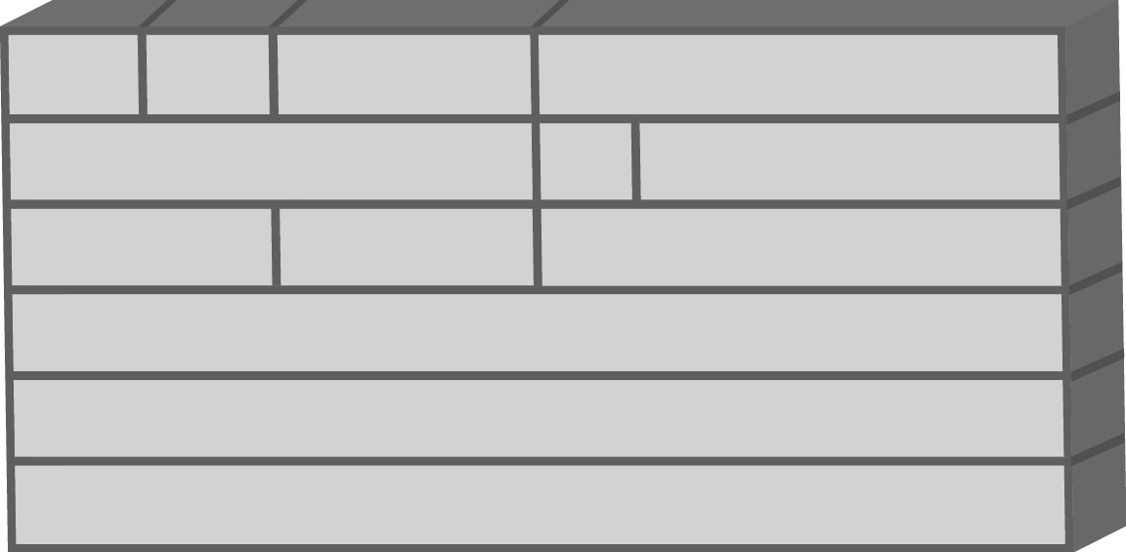
IPv4 Datagram
Bit:
0
4
8
16
31
Version
IHL
Type of Service
Total Length
Identification
Flags
Fragment Offset
Time to Live
Protocol
Header Checksum
20 octets
Source Address
Destination Address
Options + Padding
(a) IPv4

Slide 12
Format of an IPv6 Datagram
Bit:
0
4
8
16
24
31
Version
Priority
Flow Label
Payload Length
Next Header
Hop Limit
Source Address
10x32 bits = 40 octets
Destination Address
(b) IPv6
Notes:
Can you guys fix the layout

Slide 13
TCP vs UDP
Transmission Control Protocol
Connection oriented
Byte stream
Ordered: out of order packets are handled correctly
Lossless: packets repeated until acknowledged
Window based ack
Universal (User) Datagram Protocol
Connectionless
Datagram (packet) oriented
No order guaranteed
Lossy
No ack

Slide 14
Addressing
Network
Host
Extended-Network-Prefix
Network-Prefix | Subnet-Number | Host-Number
Internet Routed
Network Address
Ignored by
Internet Routers
Host Bits (h) (32-[CIDR subset mask]) | Hosts per subnet (2^{h}-2)
2 [/30] | 2
3 [/29] | 6
4 [/28] | 14
5 [/27] | 30
6 [/26] | 62
7 [/25] | 126
8 [/24] | 254
9 [/23] | 510
10 [/22] | 1022
11 [/21] | 2046
12 [/20] | 4094
13 [/19] | 8190
14 [/18] | 16382

Slide 15
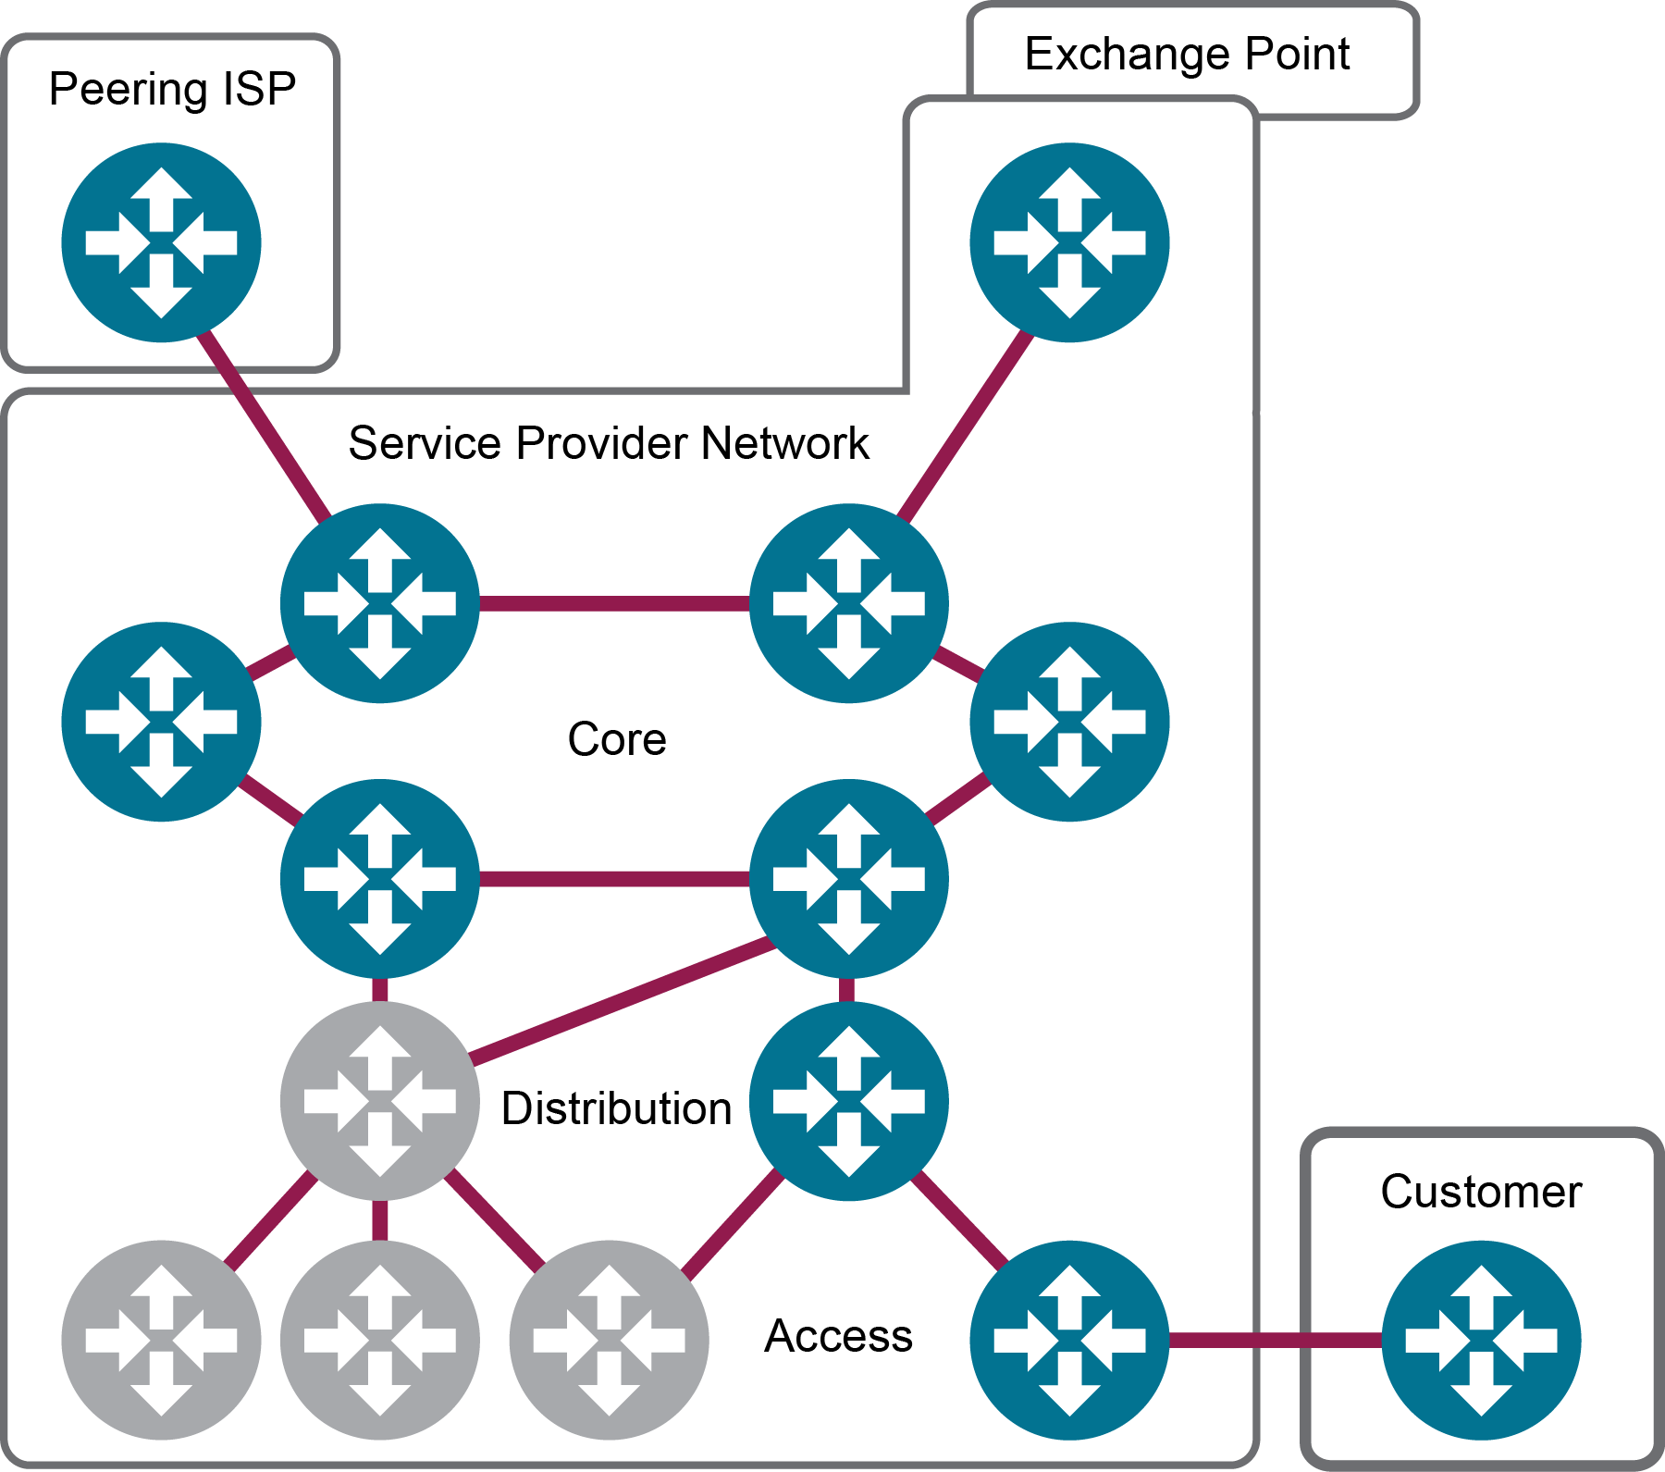
Service Provider Network

Slide 16
Internet Multimedia aka VoIP
A way to send real-time two-way media over an IP network
Real Time Protocol (RTP) – media packets
Real Time Control Protocol (RTCP) – monitor & report
Session Initiation Protocol (SIP) – call control
Session Description Protocol (SDP) – media session description

Slide 17
Real Time Transport Protocol (RTP)
RTP is a transport protocol that provides end to end delivery services for data with real time characteristics
RTP consists of two closely linked parts
RTP to carry data
RTCP to report the quality of service and to convey information about the participants in an on going session
Applications typically run RTP on top of UDP to make use of its framing, multiplexing and checksum services

Slide 18
RTP For Voice
Voice data is digitized, compressed, and packetized
Packetization implies a packetization period (playback time for one packet)
Bigger packets are more efficient (less overhead)
Smaller packets have less delay
Because you have to fill the packet before you send it
Because RTP normally rides on UDP, it is unreliable
Usually, we simply ignore errors
We also drop out of order packets

Slide 19
Session Initiation Protocol (SIP)
Internet Standard – RFC3261
RFC – http://www.ietf.org/rfc/rfc3261.txt
Reuse Internet Addressing (URIs, DNS, proxies)
Uniform Resource Identifiers: e.g. http://www.google.com, sip:brian.rosen@neustar.biz, or sip:sws1.east.verizon.net
Domain Name Service translates e.g. sws1.east.verizon.net to IP address 123.15.23.114
A “proxy” is a signaling entity in the middle of the path that usually echoes a signaling message while routing, enhancing, or policing it
Reuse HTTP Style
Text based, human readible
Makes no assumptions about underlying protocol:
TCP, UDP, etc.

Slide 20
Ideal SIP Trapezoid
SIP Signaling Goes through several intermediaries
Proxy Server
Proxy Server
SIP
SIP
SIP
RTP/RTCP
Media Goes Direct

Slide 21
SIP Session Setup Example
SIP User
Agent Client
SIP User Agent Server
INVITE sip:picard@vz.net
200 OK
ACK
Media Stream
BYE
200 OK
host.att.net
sip.vz.net

Slide 22
Proxy Server Example
SIP User Agent Client
SIP Proxy
Server
SIP User
Agent Server
INVITE sip:picard@ibm.com
INVITE sip:picard@bm.com
200 OK
200 OK
ACK
Media Stream
BYE
200 OK
Host.ibm.com
sip.neustar.biz

Slide 23
SIP Requests Example 1
Required Headers (fields):
INVITE sip:picard@ibm.com SIP/2.0
Via: SIP/2.0/UDP host.ibm.com:5060
From: Alan Johnston <sip:alan.johnston@lucent.com>
To: Jean Luc Picard <sip:picard@ibm.com>
Call-ID: 314159@host.ibm.com
CSeq: 1 INVITE
Uniquely identify this session request
}

Slide 24
SIP Requests Example 2
Typical SIP Request:
INVITE +12025551212@example.net;user=phone SIP/2.0
Via: SIP/2.0/UDP host.lucent.com:5060
From: Alan Johnston <+17035551234@lucent.com;user=phone>
To: Jean Luc Picard <+12025551212@example.net;user=phone>
Call-ID: 314159@host.lucent.com
CSeq: 1 INVITE
Contact: sip:+7035551234@lucent.com
Content-Type: application/sdp
Content-Length: 124
v=0
o=ajohnston 5462346 332134 IN IP4 host.lucent.com
t=0 0
c=IN IP4 10.64.1.1
m=audio 49170 RTP/AVP 0 3

Slide 25
SIP Responses Example 2
Typical SIP Response (Containing SDP)
SIP/2.0 200 OK
Via: SIP/2.0/UDP host.lucent.com
From: Alan Johnston <sip:+17035551234@lucent.com;user=phone>
To: Jean Luc Picard <sip:+12025551212@example.net;user=phone>
Call-ID: 314159@host.lucent.com
CSeq: 1 INVITE
Contact: sip:+12025551212@example.net;user=phone
Content-Type: application/sdp
Content-Length: 107
v=0
o=picard 124333 67895 IN IP4 example.net
t=0 0
c=IN IP4 11.234.2.1
m=audio 3456 RTP/AVP 0

Slide 26
Service Provider Network
Session Border Controller
Softswitch
Route Server
SP2
VPN
PSTN
VoIP Phone
IP Network
Session Border Controller
Softswitch
Session Border Controller
Gateway
SP1

Slide 27
Protocol Comparisons
SS7
SIP
Layered Protocol: MTP1/2/3/ISUP
Endpoints addressed by TN
Signaling not same path as media
Signaling points addressed by Point Codes
STP
SSP
Layered Protocol: Phy/Link/IP/UDP/SIP
Endpoints addressed by URI, which can contain a TN
Signaling not same path as media
“Signaling Points” addressed by URIs
SIP Proxy Server
Route Server (ENUM), sort of

Slide 28
IMS Network
IMS Services
IMS Core
Multimedia IP Networks
Operator 2
Sh
HSS
CSCF
BGCF
HLR
Mw
Mk
AS
Si
IM-SSF
Sh
BGCF
SLF
OSA-SCS
ISC
Cx
Dx
Mi
Mj
CS Domain
-or-
PSTN
-or-
Legacy
-or-
External
Mm
CSCF
MGCF
PDF
Mg
Mr
Mp
MRF-C
MRF-P
Mn
IMS Terminal
(TE and MT)
Gm
MGW
Gr
Gc
Go
CAP
Uu
GGSN
“Mb/Gi-Cloud”
Radio Access
PS Domain
Iu
Gn
SGSN

Slide 29
Routing
Today, routing is direct: TN to termination switch
There are medium term proposals to use two steps: TN to effectively SPID, SPID to POI, using ENUM
Both of these are not effective because optimal POI depends on dynamic factors:
Who the originating and termination SP are
Where the caller and called parties are (in network terms)
What the current load and failure conditions are
Routing therefore needs the first step (TN to SPID), but then needs a negotiation between origination and termination parties to determine the optimal route
This is very straightforward computer stuff, not requiring any technology that isn’t ho-hum.
But it’s not just a database – it’s an algorithm and a set of metrics dynamically determined

